Slide 1


PT. Metalurgi Mitra Abadi
Kawasan Graha Balaraja Industrial Estate Kav F7 Jl. Raya Balaraja Km 20, Balaraja, Tangerang Telp. 021-29385380
Fax. 021- 29382717

Slide 2
OUR CUSTOMERS
Cable Manufacturer
PT. Tembaga Mulia Semanan
PT. Nusantara Electric
PT. Alumina Metal Utama
PT. Walsin Lippo Industries
PT. Voksel Electric
PT. ZTT Cable
PT. Sutra Kabel Intimandiri
PT. Prima Indah Lestari
PT. Citramahasurya Industry
Automotive
PT. Suma Adikarya Cemerlang
PT. Federal Izumi Manufacturing
PT. Astra Otoparts Div. Nusametal
PT. Mitsuba Indonesia
PT. Progress Die Cast
PT. Delta Logam Makmur
PT. Edico Utama
PT. Nakakin Indonesia
PT. Nusa Keihin Indonesia
PT. Astra Honda Motor
Alloy Wheel
PT. Prima Alloy Steel Universal
PT. Bangun Sarana Alloy
PT. Meshindo Alloy
PT. Enkei Indonesia
PT. Pakoakuina
Aluminum Smelter
PT. Indonesia Asahan Aluminium
PT. Sinar Alindo Metal
PT. United Metal Indonesia
PT. Berkah Logam Makmur
PT. Molten Aluminium Producer Indonesia
PT. Daiki Aluminium Industry Indonesia
PT. HP Metal Indonesia
PT. Kairos Logam Makmur
PT. Sumi Win Mukti
Al Sheet / Al Foil / Extrusion
PT. Mitra Alumindo Selaras
PT. Inkasa Jaya Aluminium
PT. Alumindo Light Metal Indonesia
PT. Evanindo Mega Persada
PT. ATA International

Slide 3
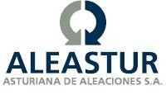

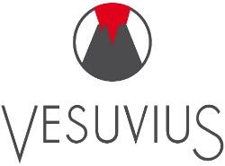


Business Line:
Complete Range Chemicals for Metals melt treatments, Alloying Materials, Master Alloy, Silicone Metal, Magnesium, Blasting Media, Crucible, Die Lubricant, Coating, Refractory for Ferrous and Non Ferrous Foundry Industry, Wire Drawing Lubricant.
Our Principals:
Distributor for Aleastur, Spain
Distributor for A.Cesana, Italy
Distributor for Vesuvius, United Kingdom
Distributor for JC Crucible, China
Distributor for Condat Lubricant, France

Slide 4
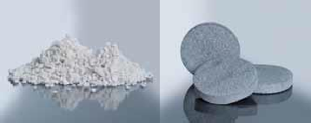
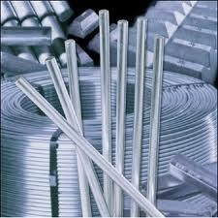
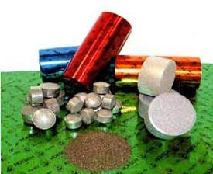
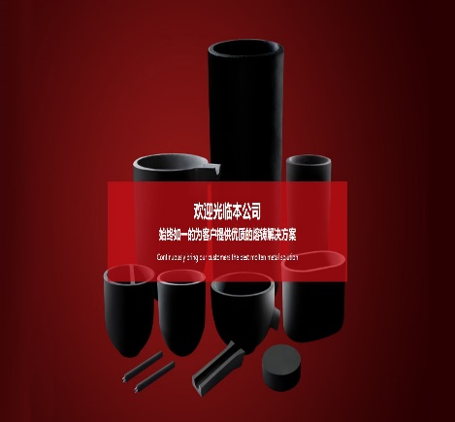
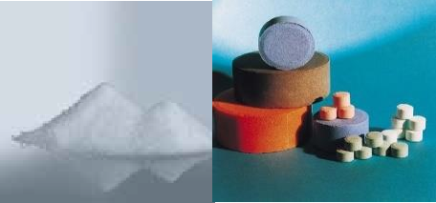
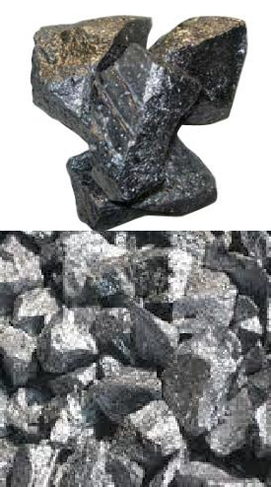
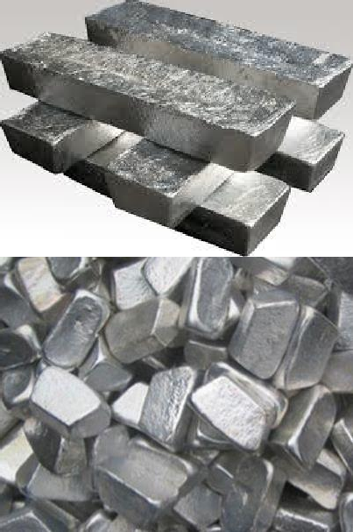
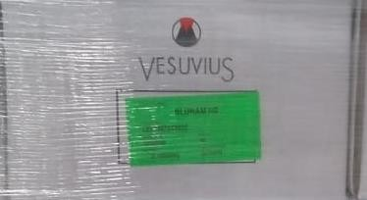
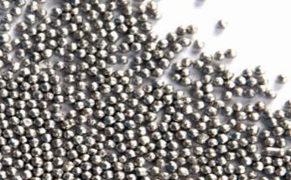
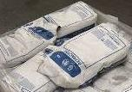
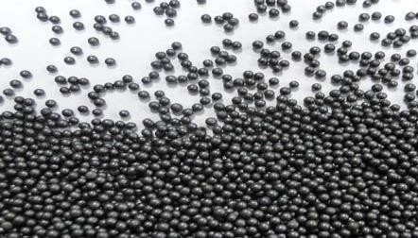
OUR PRODUCT
Special Fluxes
Master Alloy
Alloying
Compact/Tablet
Crucible
Silicone Metal
Magnesium
Refractory
Abrasive Media

Slide 5

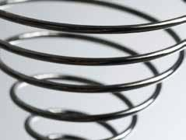

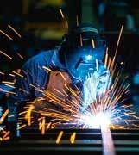
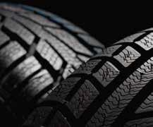









Slide 6
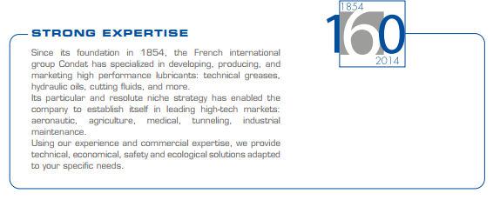
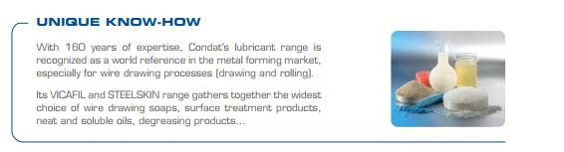
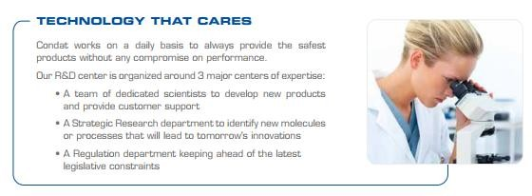

Slide 7
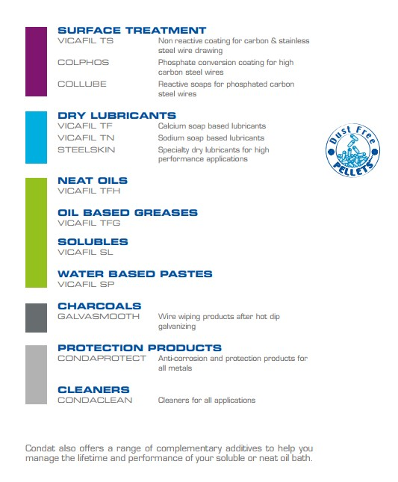



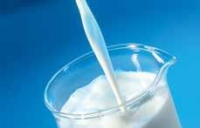
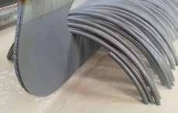
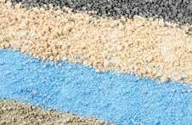

Slide 8









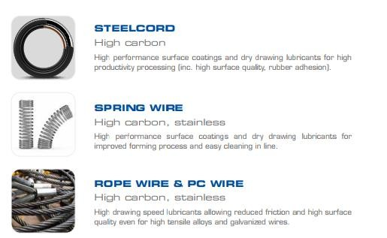
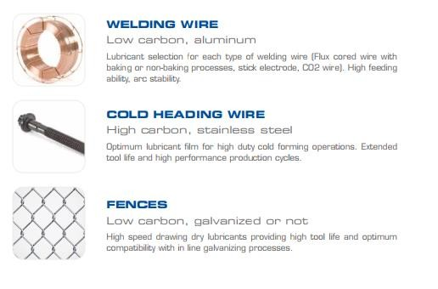

Slide 9

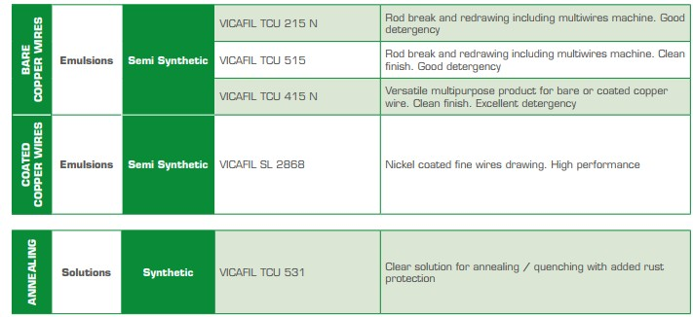
Water-based lubricants are the most commonly used fluids for copper & copper alloys cold drawing applications. They are defined as those where water is the main phase. Basically, water-based fluids combine the cooling properties of water with lubricating properties of oil and/or various technical additives.
Various families are used and these can be classified according to their appearance in aqueous media as follows: soap-fat compounds, water-soluble oils, semi-synthetic and synthetic solutions.

Slide 10


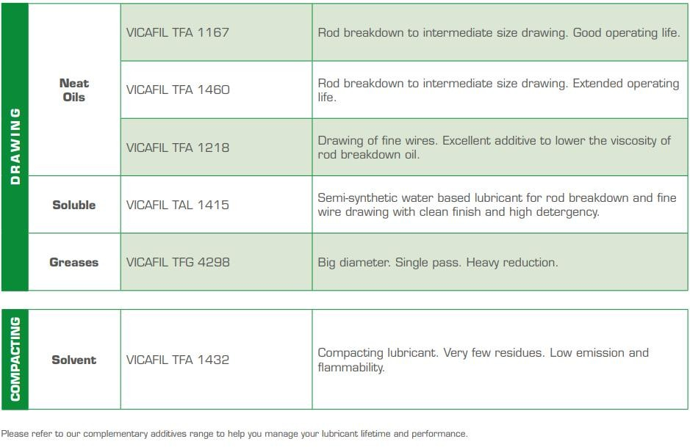
Synthetic products will ensure no residue and stain on the aluminum surface after annealing and will then leave a very clean surface while semi synthetic products will provide high lubricating properties as well as long life in service due to high level of additivation and strong detergent properties.
A large spectrum of viscosity enables us to cover all customers requirements from large to small diameters.

Slide 11
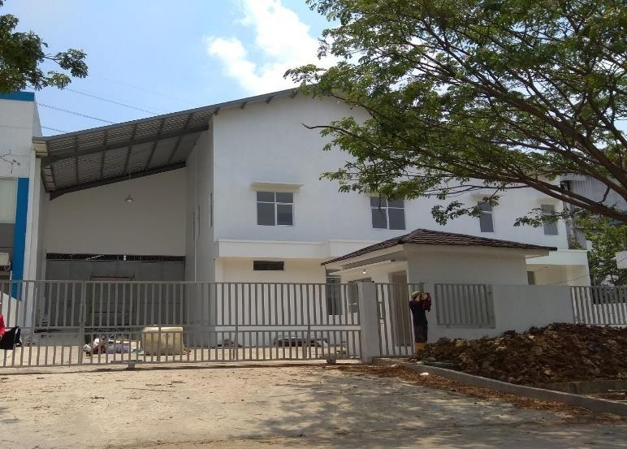
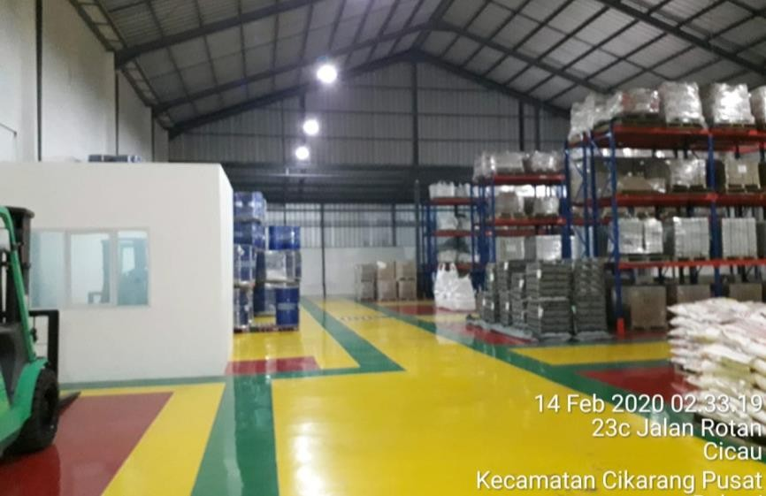
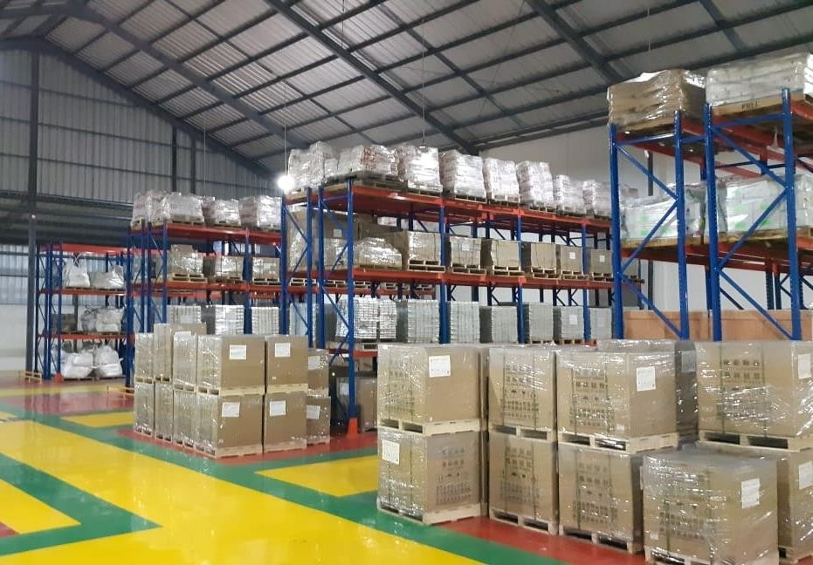
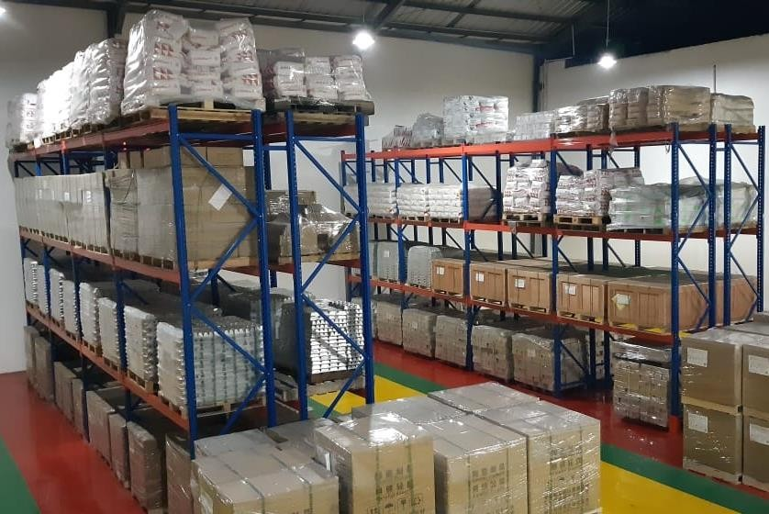
OUR STORAGE

Slide 12
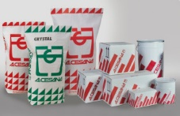
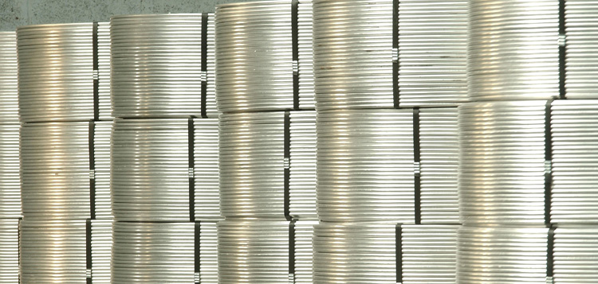


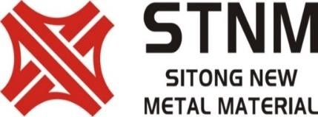
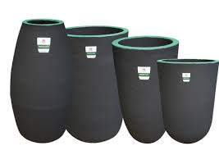
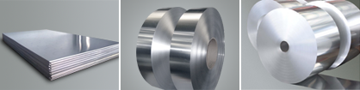
OUR PRINCIPLE FACTORY

Slide 13
I. Flux
PRODUCT INDEX :
Environmentally Friendly, Small addition rate (ISO14000)
Covering , Refining / Cleaning, Drossing Off
Available in Powder and Granular Type
Special Flux contains with Low Sodium or Sodium Free
Cleaning Furnace Wall
Special Flux to remove and clean thick layers of aluminium
oxide (Al2O3)

Slide 14
I. Flux
PRODUCT INDEX :
Environmentally Friendly, Small addition rate (ISO14000)
Non Metallic Removal (Calcium, Natrium, Lithium or Magnesium)
Reduce Castability and Homogeneous alloy structure
Available in Powder or Granular type
Covering and Cleaning Zinc Alloy
Reduce formation Zinc Oxide and Metal Losses

Slide 15
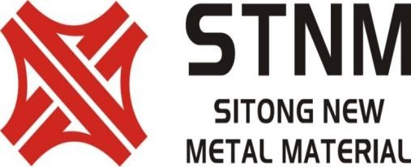
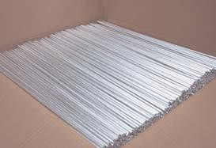
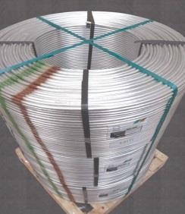
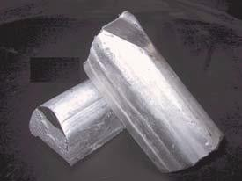
II. Master Alloy
PRODUCT INDEX :
1. Grain Refiner : ALTi5B1 , AlTi5B0.2
Type of Grain Refiner :
Rod Stick Coils Conti Bar
2. Modifier : AlSr 10%
Type of Modifier :
Rod Stick

Slide 16
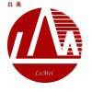
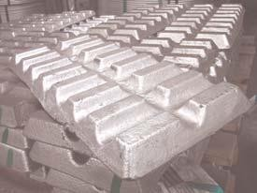
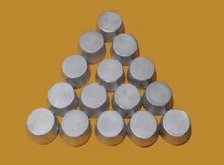
II. Master Alloy
PRODUCT INDEX :
3. Other Master Alloy
AL B 8%
AL Zr 10%
AL P 3,5% / 5%

Slide 17

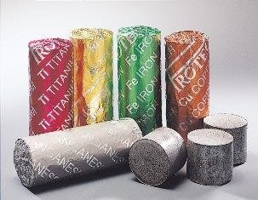
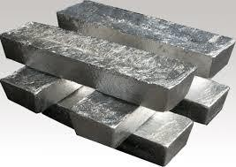
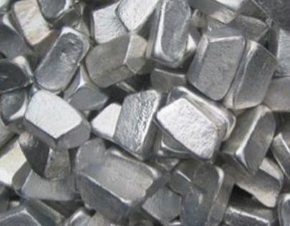
III. Alloying Element :
PRODUCT INDEX
High Concentrate Aluminium Alloying Element
ALTab Fe 80%, ALTab Mn 80%, ALTab Ti 80%, ALTab Cu 80%, ALTab Cr 75%
IV. Magnesium Ingot
ALTab Fe 80%, ALTab Mn 80%,

Slide 18

V. COATING and DIE LUBRICANT
PRODUCT INDEX :
Coating For Ladle and Mould
Special Non Wetting Coat with Titanium or Zircon material
Avaiable Water base or Oil base
Die Lubricant
Special Lubricant to protect and lubricate the dies

Slide 19
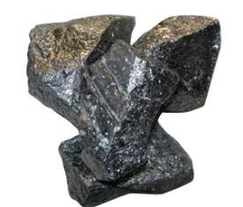
VI. Silicone Metal
PRODUCT INDEX :
Many type of Silicone Metal for Non Ferrous :
Silicone Metal 2502
Silicone Metal 3303
Silicone Metal 441
Silicone Metal 553

Slide 20
VII. Refractory
PRODUCT INDEX :
High Quality Refractory From Vesuvius
Special Castable
- Low Cement Castable, Ultra Low Cement and Non Wetting Material
Special Phos Bond (Bluram)
Special Mortar

Slide 21
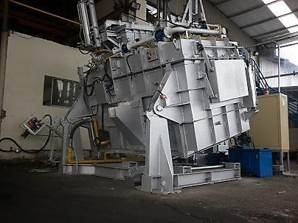
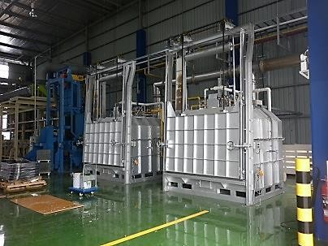
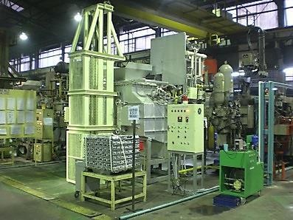



PRODUCT INDEX :
VIII. Furnace Fabrication
Central Melting Furnace (Tilting Type)
Annealing Furnace
Holding Melting Furnace
Furnace Repair
Hardening & Tempering Furnace
Central Melting 1,000Kg/H

Slide 22
PT. Metalurgi Mitra Abadi
Terima Kasih

